Slide 1

ROS - Lesson 10
Fall 2014
Teaching Assistant: Roi Yehoshua
roiyeho@gmail.com

Slide 2
Agenda
Gazebo 3D simulator
Loading and creating maps in Gazebo
Model SDF files
Gazebo and ROS integration
Using our URDF 3D model in Gazebo

Slide 3
Gazebo
Gazebo is a multi-robot simulator
Like Stage, it is capable of simulating a population of robots, sensors and objects, but does so in a 3D world
Includes an accurate simulation of rigid-body physics and generates realistic sensor feedback
Allows code designed to operate a physical robot to be executed in an artificial environment
Gazebo is under active development at the OSRF (Open Source Robotics Foundation)
Gazebo Demo

Slide 4
Gazebo Features
Dynamics Simulation
3D Models Building Editor
Advanced 3D Graphics
Support for different types of sensors
Robot Models
Support for different objects from simple shapes to complex terrains
Programmatic Interfaces
Support for ROS
API for custom interfaces

Slide 5
Gazebo Installation
ROS Indigo comes with Gazebo V2.0
Latest version of Gazebo is V4.0
You can install it from here, but you also need to connect it to ROS by installing gazebo4_ros_pkgs
Gazebo home page - http://gazebosim.org/
Gazebo tutorials - http://gazebosim.org/tutorials

Slide 6
Gazebo Architecture
Gazebo consists of two processes:
Server: Runs the physics loop and generates sensor data
Executable: gzserver
Libraries: Physics, Sensors, Rendering, Transport
Client: Provides user interaction and visualization of a simulation.
Executable: gzclient
Libraries: Transport, Rendering, GUI

Slide 7
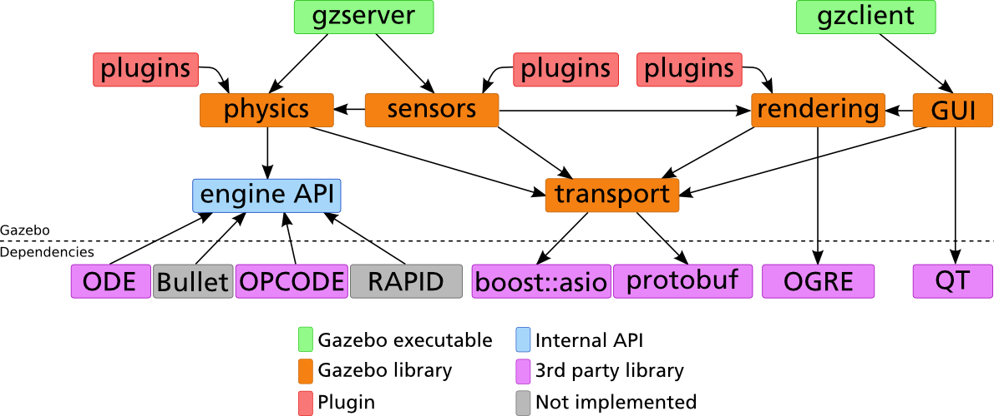
Gazebo Architecture

Slide 8
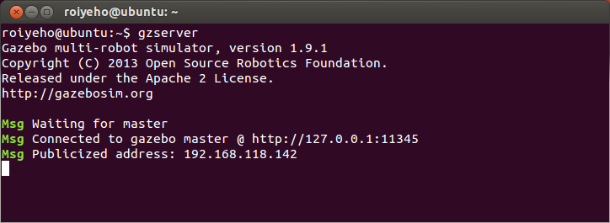
Running Gazebo
To run the Gazebo server type:
This will start the physics engine with an empty world
Expected output:
$ gzserver

Slide 9
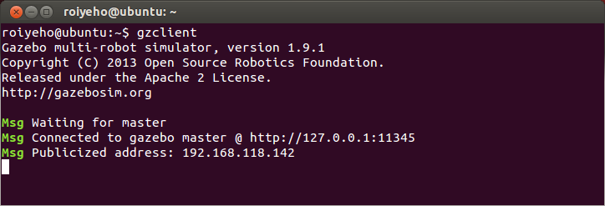
Running Gazebo
To run the Gazebo GUI client type:
This will connect to the server and give you a graphical display of the simulation.
Expected output:
$ gzclient

Slide 10
Running Gazebo from ROS
To launch both the Gazebo server and GUI:
To launch only the client:
To launch only the server:
$ rosrun gazebo_ros gazebo
$ rosrun gazebo_ros gui
$ rosrun gazebo_ros gzserver

Slide 11
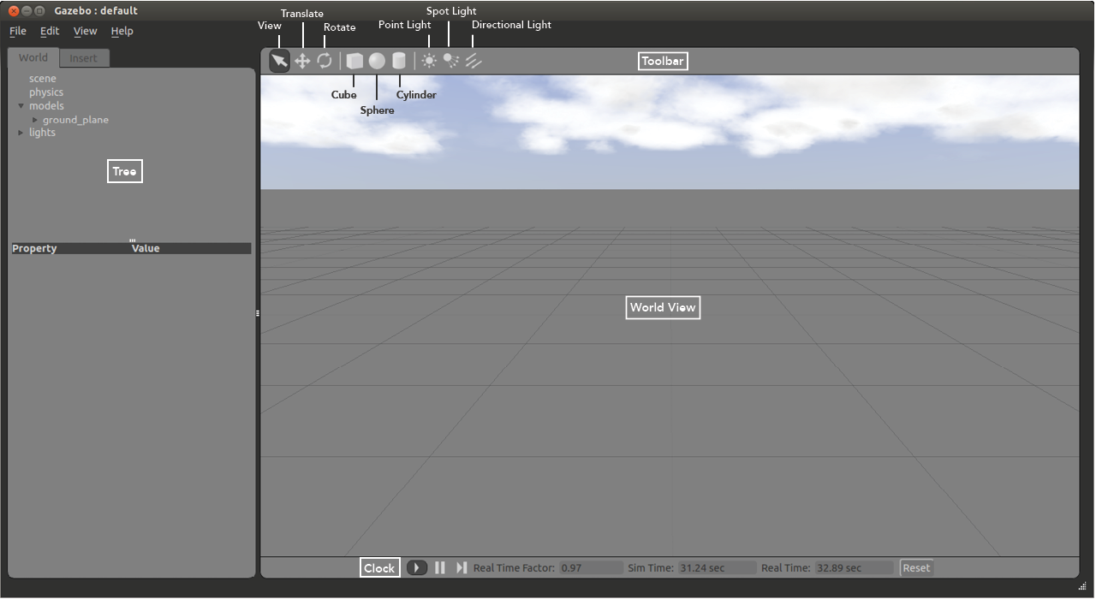
Gazebo User Interface

Slide 12
The World View
The World View displays the world and all of the models therein
Here you can add, manipulate, and remove models
You can switch between View, Translate and Rotate modes of the view in the left side of the Toolbar
In View Mode you can navigate around the world by panning, orbiting and zooming
Translate Mode lets users translate an object
Rotate Mode lets you rotate an object

Slide 13
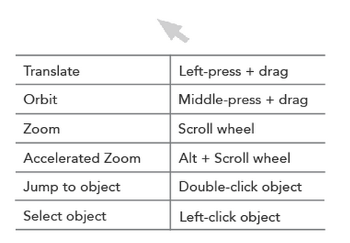
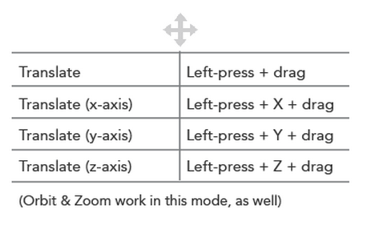
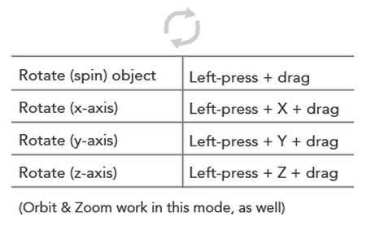
World View Shortcuts
View Mode
Translate Mode
Rotate Mode

Slide 14
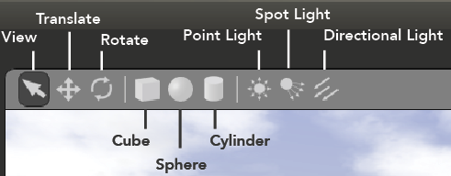
Toolbar
The Toolbar provides tools with which to navigate and manipulate the world
The Cube, Sphere and Cylinder icons let users add these simple shapes to the world
The Point Light, Spot Light and Directional Light icons allow users to insert light into the world

Slide 15
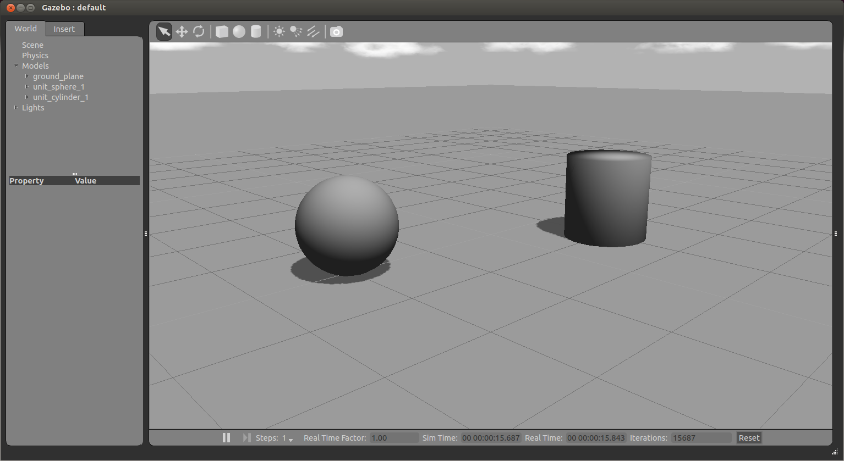
Adding Shapes

Slide 16
The Tree
The Tree lists the models in the world and allows you to add new models
The Tree consists of the World and Insert tabs

Slide 17
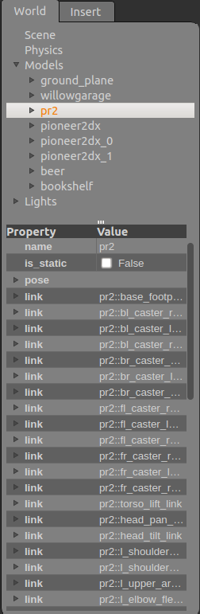
The World Tab
This tab is divided into Scene, Physics, Models, and Lights
You can change the values of the properties in the bottom half of the window

Slide 18
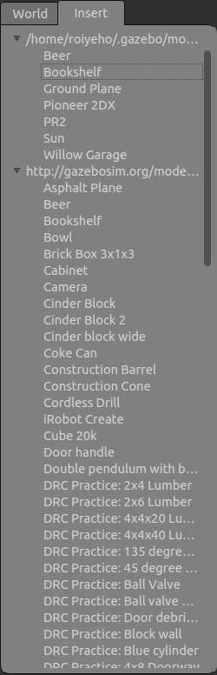
The Insert Tab
Displays all of the models available for use in Gazebo
The first directory is your directory of local models
The second directory is the Gazebo model database
Once a model has been inserted from here, it will appear in the local directory as well

Slide 19
The Insert Tab
To add a model to the world:
left-click on the desired model in the Insert Tab
move the cursor to the desired location in World View
left-click again to release
Use the Translate and Rotate modes to orient the model more precisely

Slide 20
Gazebo Models Repository
Gazebo maintains the models repository at:
https://bitbucket.org/osrf/gazebo_models/src
http://old.gazebosim.org
You can download a model directly from the Gazebo models repository into your local repository by typing:
wget http://old.gazebosim.org/models/[name of model]/model.tar.gz .
tar xvf model.tar.gz -C ~/.gazebo/models

Slide 21
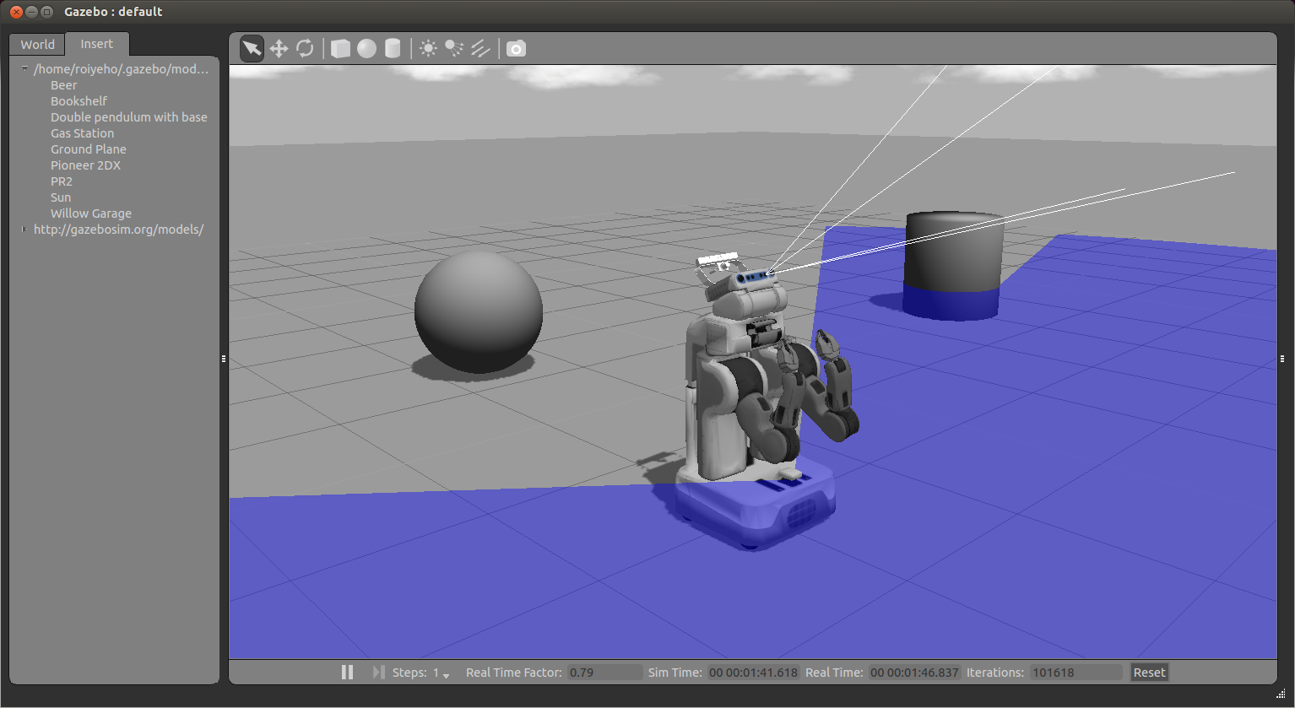
Inserting PR2 Robot

Slide 22
Models Item
The models item in the world tab contains a list of all models and their links
Right-clicking on a model in the Models section gives you three options:
Move to – moves the view to be directly in front of that model
Follow
View – allows you to view different aspects of the model, such as Wireframe, Collisions, Joints
Delete – deletes the model

Slide 23
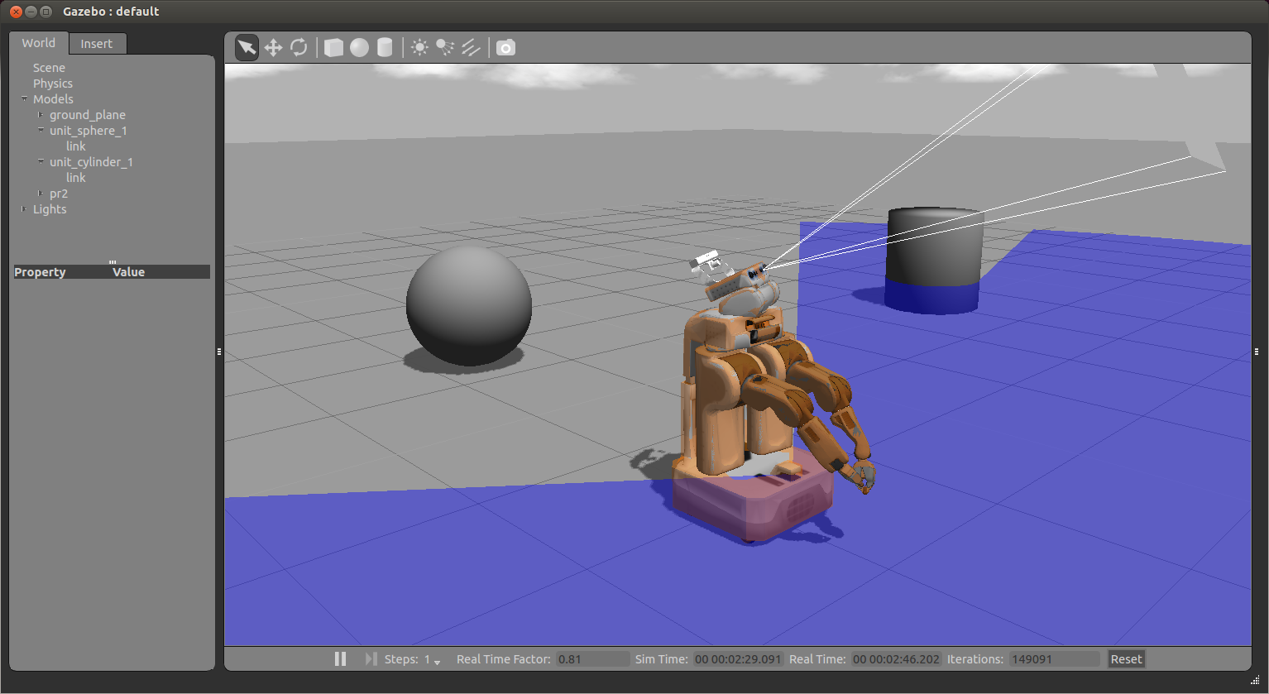
Collisions View

Slide 24
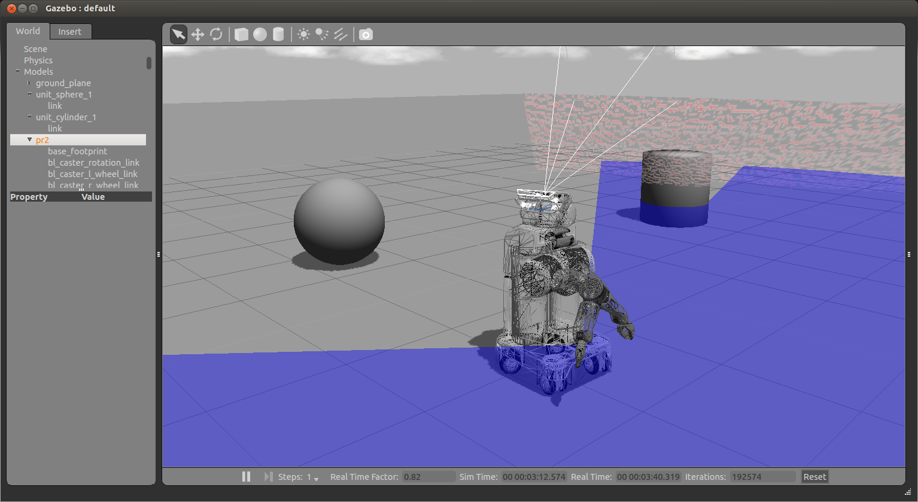
Wireframe View

Slide 25
Clock
You can start, pause and step through the simulation with the clock
It is located at the bottom of the World View
Real Time Factor: Displays how fast or slow the simulation is running in comparison to real time
A factor less than 1.0 indicates simulation is running slower than real time
Greater then 1.0 indicates faster than real time

Slide 26
Building Editor
The Building Editor allows you to create models of multi-level buildings without writing any code
Buildings can contain doorways, windows and stairs
To access the Building Editor, go to the Edit menu and select Building Editor
At the end of the construction process, the Building Creator creates an SDF file that can be used in Gazebo

Slide 27
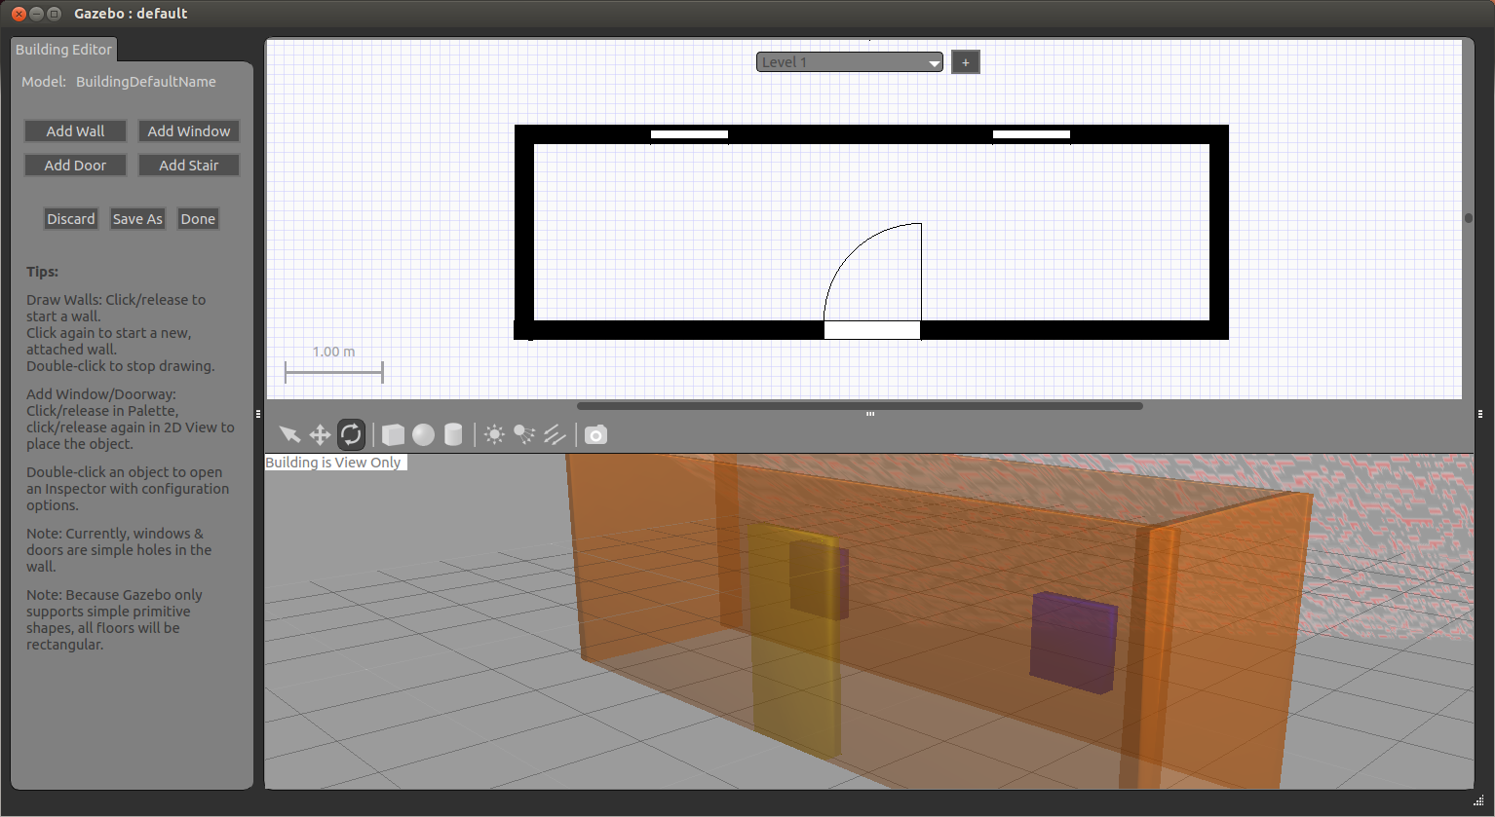
Building Editor

Slide 28
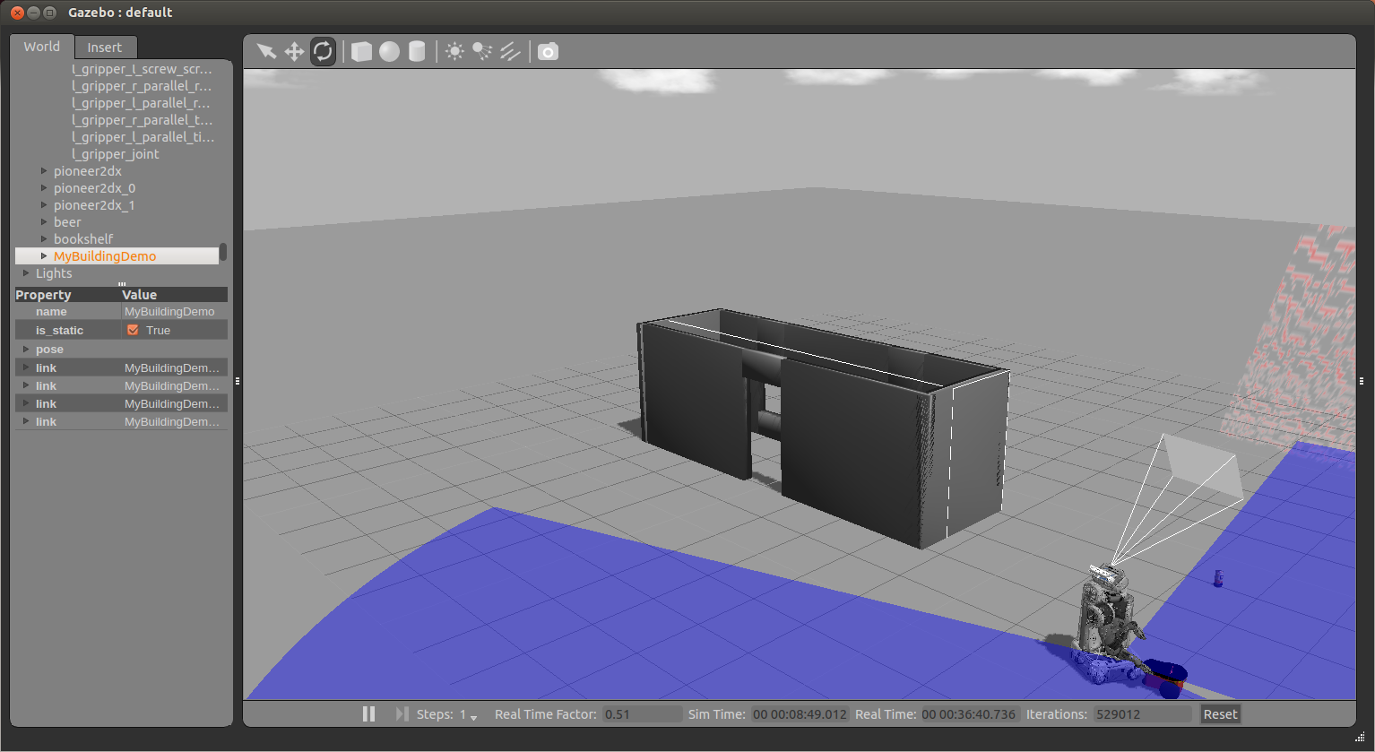
The Building in Gazebo

Slide 29
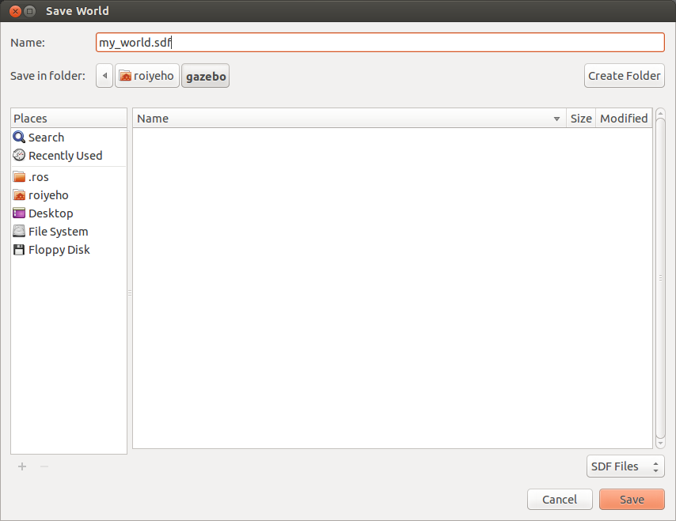
Saving a World
Once you are happy with a world it can be saved through the File->Save As menu.
Enter my_world.sdf as the file name and click OK

Slide 30
Loading a World
A saved world may be loaded on the command line:
The filename must be in the current working directory, or you must specify the complete path
$ gazebo my_world.sdf

Slide 31
Simulation Description Format (SDF)
SDF is an XML file that contains a complete description for everything from the world level down to the robot level, including:
Scene: Ambient lighting, sky properties, shadows.
Physics: Gravity, time step, physics engine.
Models: Collection of links, collision objects, joints, and sensors.
Lights: Point, spot, and directional light sources.
Plugins: World, model, sensor, and system plugins.
http://gazebosim.org/sdf.html

Slide 32
SDF vs URDF
URDF can only specify the kinematic and dynamic properties of a single robot in isolation
URDF can not specify the pose of the robot itself within a world
It cannot specify objects that are not robots, such as lights, heightmaps, etc.
Lacks friction and other properties
SDF is a complete description for everything from the world level down to the robot level

Slide 33
World Description File
The world description file contains all the elements in a simulation, including robots, lights, sensors, and static objects
This file is formatted using SDF and has a .world extension
The Gazebo server (gzserver) reads this file to generate and populate a world

Slide 34
Example World Files
Gazebo ships with a number of example worlds
World files are found within the /worlds directory of your Gazebo resource path
A typical path might be /usr/share/gazebo-2.0
In gazebo_ros package there are built-in launch files that load some of these world files
For example, to launch willowgarage_world type:
$ roslaunch gazebo_ros willowgarage_world.launch

Slide 35
willowgarage.world
<?xml version="1.0" ?>
<sdf version="1.4">
<world name="default">
<include>
<uri>model://ground_plane</uri>
</include>
<include>
<uri>model://sun</uri>
</include>
<include>
<uri>model://willowgarage</uri>
</include>
</world>
</sdf>
In this world file snippet you can see that three models are referenced
The three models are searched for within your local Gazebo Model Database
If not found there, they are automatically pulled from Gazebo's online database

Slide 36
Launch World Files
In gazebo_ros package there are built-in launch files that load some of these world files
For example, to launch willowgarage_world type:
$ roslaunch gazebo_ros willowgarage_world.launch

Slide 37
willowgarage_world.launch
<launch>
<!-- We resume the logic in empty_world.launch, changing only the name of the world to be launched -->
<include file="$(find gazebo_ros)/launch/empty_world.launch">
<arg name="world_name" value="worlds/willowgarage.world"/> <!-- Note: the world_name is with respect to GAZEBO_RESOURCE_PATH environmental variable -->
<arg name="paused" value="false"/>
<arg name="use_sim_time" value="true"/>
<arg name="gui" value="true"/>
<arg name="headless" value="false"/>
<arg name="debug" value="false"/>
</include>
</launch>
This launch file inherits most of the necessary functionality from empty_world.launch
The only parameter we need to change is the world_name parameter, substituting the empty.world world file with willowgarage.world
The other arguments are simply set to their default values

Slide 38
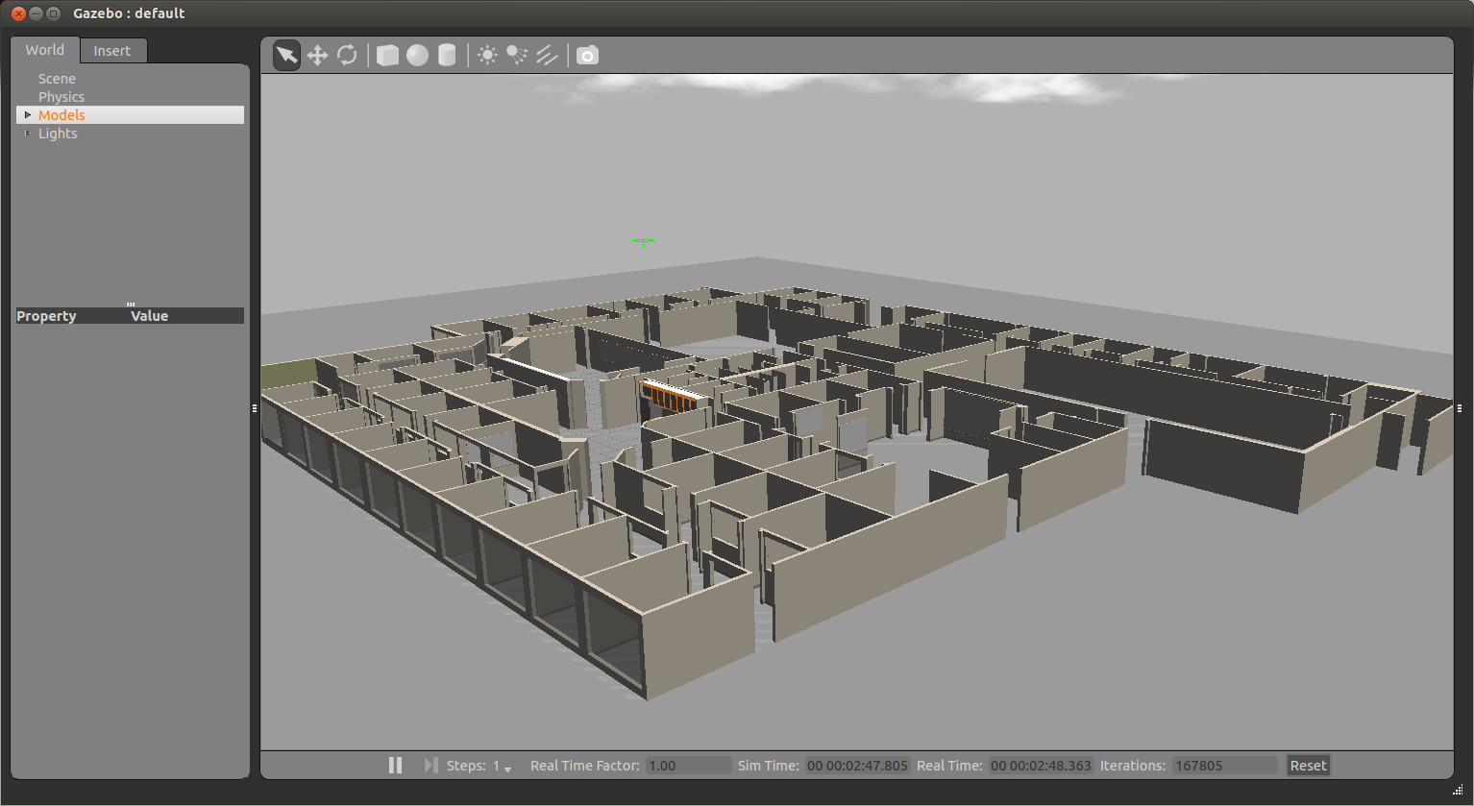
Willow Garage World

Slide 39
Model Files
A model file uses the same SDF format as world files, but contains only a single <model> tag
Once a model file is created, it can be included in a world file using the following SDF syntax:
You can also include any model from the online database and the necessary content will be downloaded at runtime
<include filename="model_file_name"/>

Slide 40
willowgarage Model SDF File
<?xml version="1.0" ?>
<sdf version="1.4">
<model name="willowgarage">
<static>true</static>
<pose>-20 -20 0 0 0 0</pose>
<link name="walls">
<collision name="collision">
<geometry>
<mesh>
<uri>model://willowgarage/meshes/willowgarage_collision.dae</uri>
</mesh>
</geometry>
</collision>
<visual name="visual">
<geometry>
<mesh>
<uri>model://willowgarage/meshes/willowgarage_visual.dae</uri>
</mesh>
</geometry>
<cast_shadows>false</cast_shadows>
</visual>
</link>
</model>
</sdf>

Slide 41
Components of Models
Links: A link contains the physical properties of one body of the model. This can be a wheel, or a link in a joint chain.
Each link may contain many collision, visual and sensor elements
Collision: A collision element encapsulates a geometry that is used to collision checking.
This can be a simple shape (which is preferred), or a triangle mesh (which consumes greater resources).
Visual: A visual element is used to visualize parts of a link.
Inertial: The inertial element describes the dynamic properties of the link, such as mass and rotational inertia matrix.
Sensor: A sensor collects data from the world for use in plugins.
Joints: A joint connects two links.
A parent and child relationship is established along with other parameters such as axis of rotation, and joint limits.
Plugins: A shared library created by a 3D party to control a model.

Slide 42
Gazebo + ROS Integartion
The set of ROS packages for interfacing with Gazebo are contained in gazebo_ros_pkgs
This package provides the necessary interfaces to simulate a robot in Gazebo using ROS messages, services and dynamic reconfigure

Slide 43
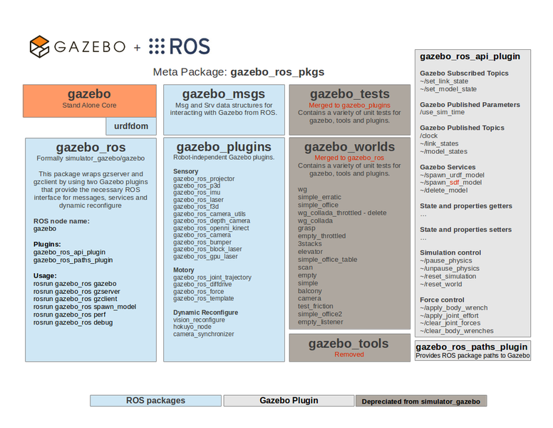
Gazebo + ROS Integration

Slide 44
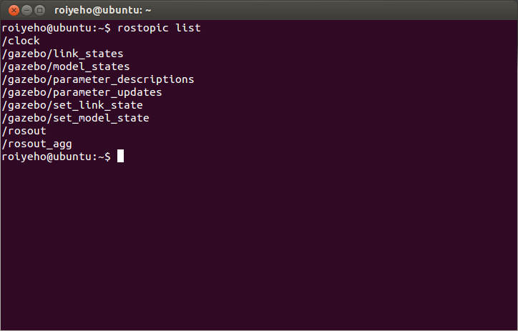
Gazebo ROS Topics

Slide 45
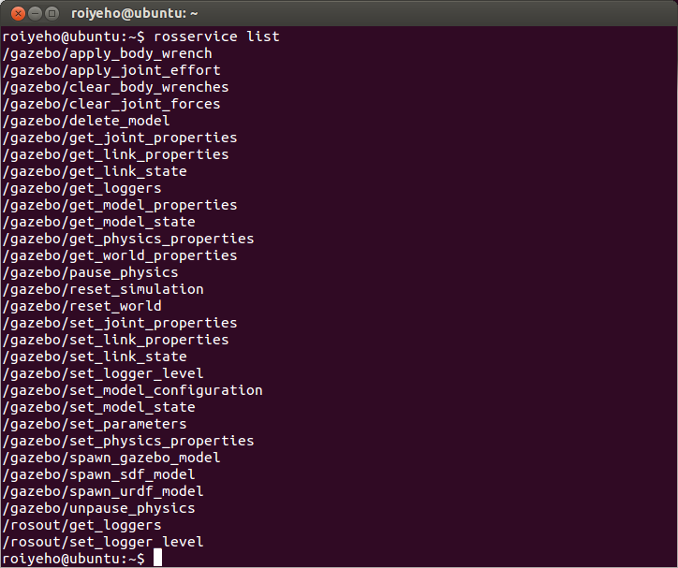
Gazebo ROS Services

Slide 46
Gazebo ROS Package Structure
Typical Gazebo+ROS package structure:
The robot's model and description are located in a package named /MYROBOT_description
The world and launch files used with Gazebo is located in a package named /MYROBOT_gazebo
Replace MYROBOT with the name of your robot or something like “test” if you don’t have one

Slide 47
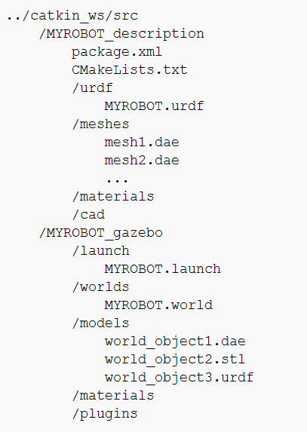
Gazebo ROS Package Structure

Slide 48
Creating a Custom World File
In the following tutorial we'll make an empty world with a ground, a sun, a gas station and an r2d2 robot
Create ROS packages r2d2_gazebo and r2d2_description:
Within the r2d2_gazebo package, create a launch folder
In the launch folder create a r2d2.launch file with the following contents
$ cd ~/catkin_ws
$ catkin_create_pkg r2d2_gazebo
$ catkin_create_pkg r2d2_description

Slide 49
r2d2.launch
<launch>
<!-- We resume the logic in empty_world.launch, changing only the name of the world to be launched -->
<include file="$(find gazebo_ros)/launch/empty_world.launch">
<arg name="world_name" value="$(find r2d2_gazebo)/worlds/r2d2.world"/>
<!-- more default parameters can be changed here -->
</include>
</launch>

Slide 50
Creating a Custom World File
Within the same package, create a worlds folder, and create a r2d2.world file with the following:
<?xml version="1.0" ?>
<sdf version="1.4">
<world name="default">
<include>
<uri>model://ground_plane</uri>
</include>
<include>
<uri>model://sun</uri>
</include>
<include>
<uri>model://gas_station</uri>
<name>gas_station</name>
<pose>-2.0 7.0 0 0 0 0</pose>
</include>
</world>
</sdf>

Slide 51
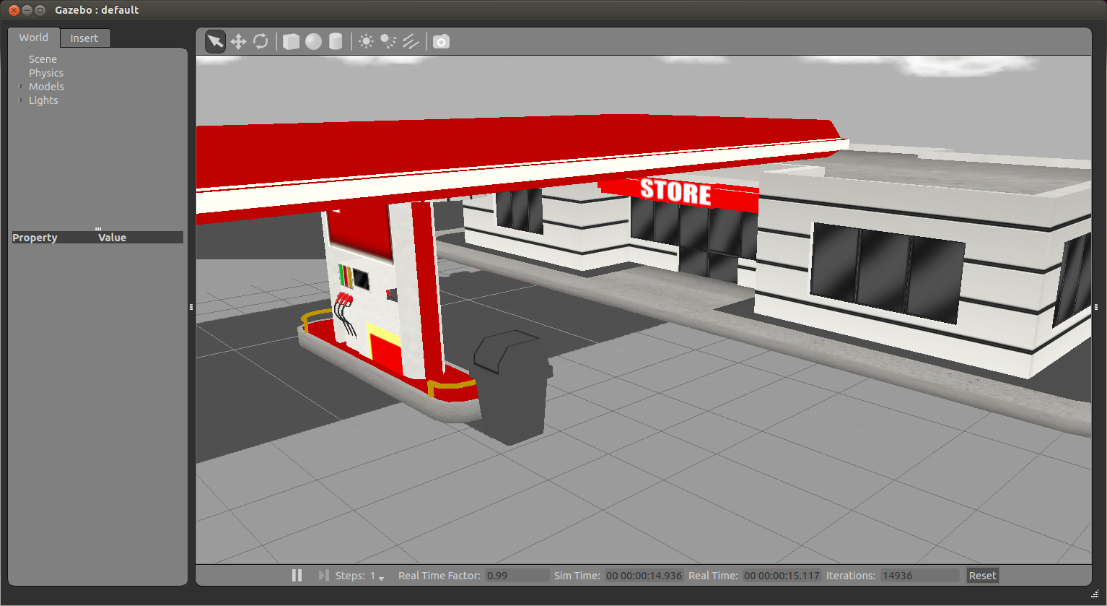
Creating a Custom World File
You should now be able to launch your custom world into Gazebo using the following command:
$ roslaunch r2d2_gazebo r2d2.launch

Slide 52
Spawn URDF Robots
Within the r2d2_description package, create a urdf folder, and copy 07-physics.urdf from the urdf_tutorial package
$ cp 07-physics.urdf ~/catkin_ws/src/r2d2_description/urdf/r2d2.urdf

Slide 53
Spawn URDF Robots
To launch your URDF-based robot into Gazebo you use ROS service all spawn method
The spawn_model node in gazebo_ros package makes a service call request to the gazebo ROS node in order to add a custom URDF into Gazebo
You can use this script in the following way:
$ rosrun gazebo_ros spawn_model -file `rospack find r2d2_description`/urdf/r2d2.urdf -urdf -x 0 -y 0 -z 1 -model r2d2

Slide 54
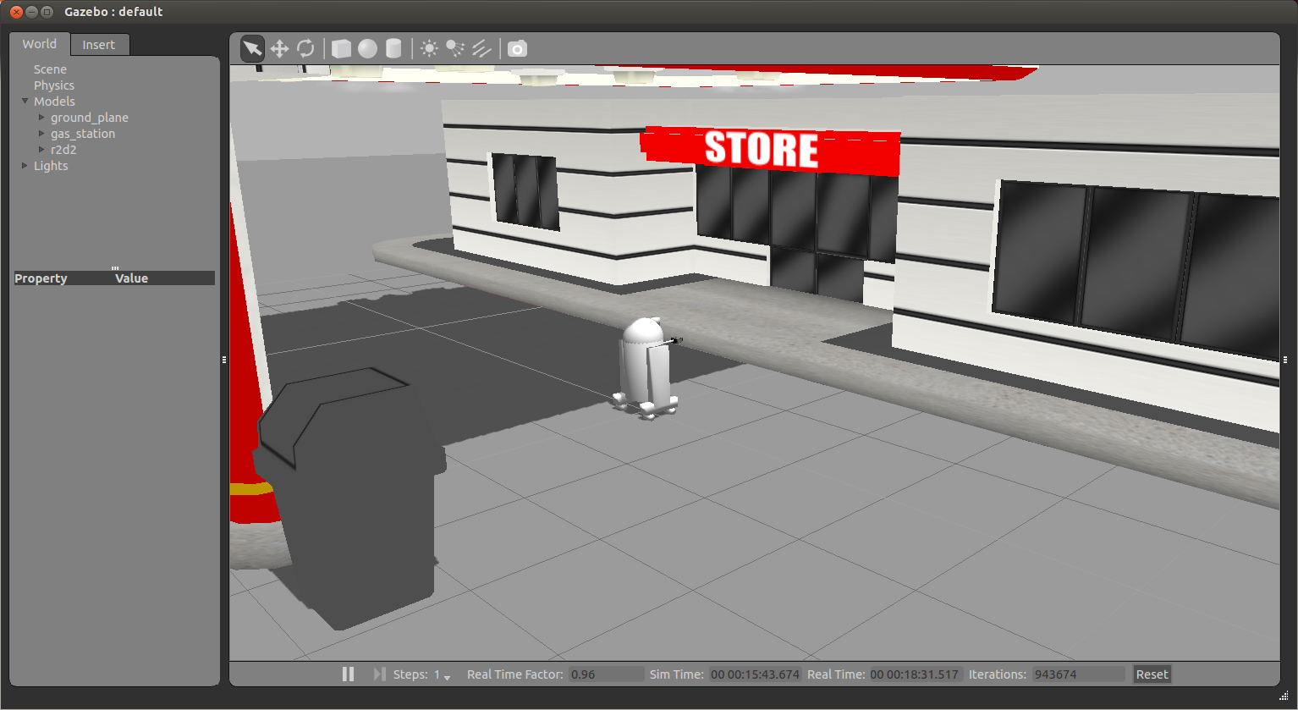
Spawn URDF Robots

Slide 55
Spawn URDF Robots
To integrate this directly into a ROS launch file, reopen the file r2d2_gazebo/launch/r2d2.launch and add the following before the </launch> tag:
<!-- Spawn a robot into Gazebo -->
<node name="spawn_urdf" pkg="gazebo_ros" type="spawn_model" args="-file $(find r2d2_description)/urdf/r2d2.urdf -urdf -z 1 -model r2d2" />

Slide 56
XACRO Example with PR2
If your URDF is not in XML format but rather in XACRO format, you can make a similar modification to your launch file
For example, to spawn a PR2 robot add the following to your launch file:
<!-- Convert an xacro and put on parameter server -->
<param name="robot_description" command="$(find xacro)/xacro.py $(find pr2_description)/robots/pr2.urdf.xacro" />
<!-- Spawn a PR2 robot into Gazebo -->
<node name="spawn_pr2_urdf" pkg="gazebo_ros" type="spawn_model" args="-param robot_description -urdf -x 2 -model pr2" />

Slide 57
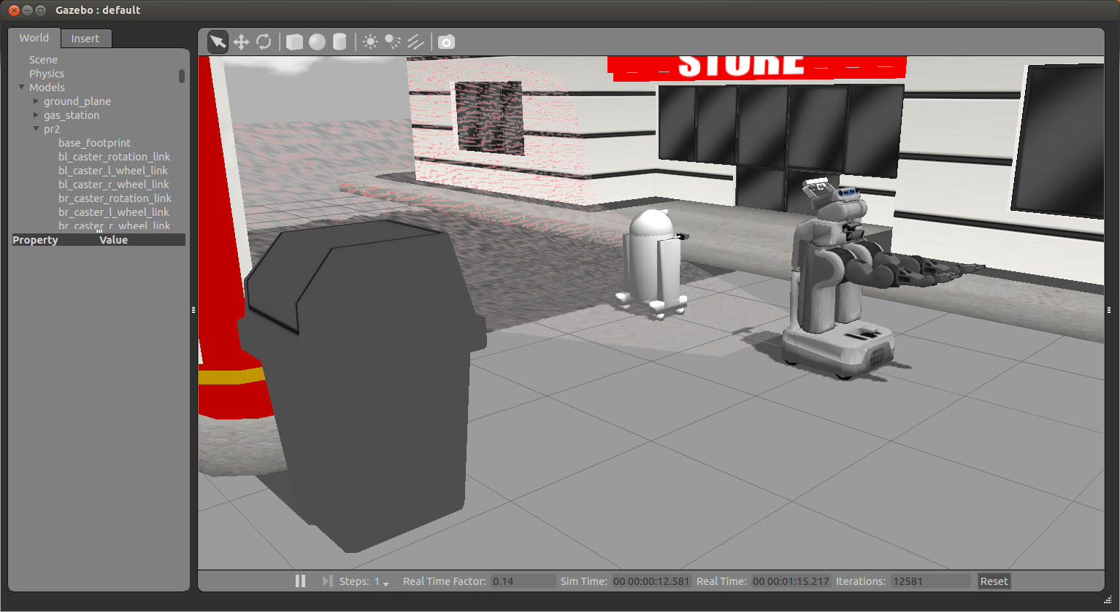
XACRO Example with PR2

Slide 58
Using URDF In Gazebo
To use a URDF file in Gazebo, some additional simulation-specific tags must be added to work properly with Gazebo
Adding these tags saves you from having to create a separate SDF file from scratch and duplicating description formats
Under the hood, Gazebo converts the URDF to SDF automatically

Slide 59
Using URDF In Gazebo
Required
An <inertia> element within each <link> element must be properly specified and configured
It’s important to specify both the <visual> and <collision> tags for each link, otherwise Gazebo will treat the link as "invisible" to laser scanners and collision checking
Optional
Add a <gazebo> element for every <link>
Convert visual colors to Gazebo format
Convert stl files to dae files for better textures
Add sensor plugins
Add a <gazebo> element for every <joint>
Set proper damping dynamics
Add actuator control plugins
Add a <gazebo> element for the <robot> element
Add a <link name="world"/> link if the robot should be rigidly attached to the world/base_link

Slide 60
The <gazebo> Element
The <gazebo> element is an extension to the URDF used for specifying additional properties needed for simulation purposes in Gazebo
None of the elements within a <gazebo> element are required because default values will be automatically included
There are 3 types of <gazebo> elements - for the <robot>, <link> tags, and <joint> tags

Slide 61
Adding Materials
A standard URDF can specify colors in the link:
This method of specifying link colors does not work in Gazebo
Instead, a Gazebo material tag must be specified for each link, such as:
<link name="base_link">
<visual>
<material name="blue">
<color rgba="0 0 .8 1"/>
</material>
</visual>
</link>
<gazebo reference="base_link">
<material>Gazebo/Blue</material>
</gazebo>

Slide 62
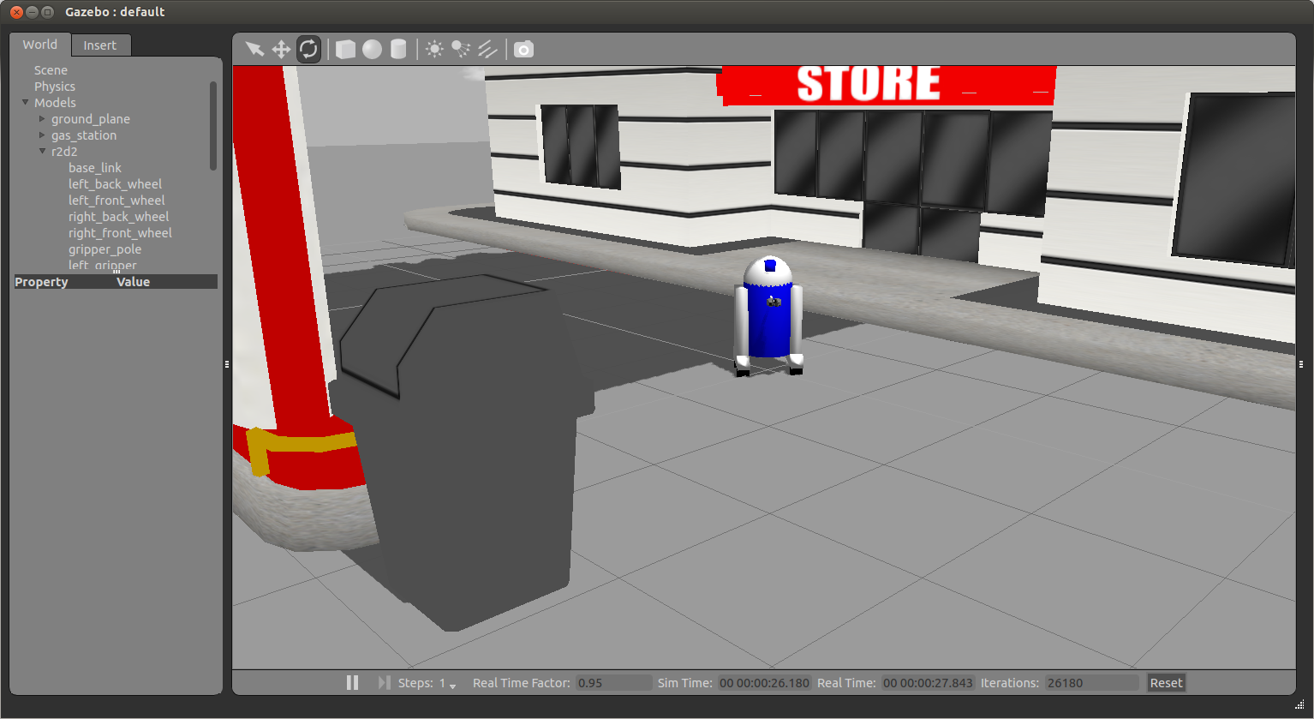
Adding Materials

Slide 63
Adding Materials
The default available materials in Gazebo can be found in the Gazebo source code at /usr/share/gazebo-[Gazebo version]/ media/materials/scripts/gazebo.material

Slide 64
Joints
Not all of the elements documented for URDF joints are applicable to Gazebo:
The <origin>, <parent> and <child> are required
<calibration> and <safety_controller> are ignored
In the <dynamics> tag, only the damping property is used
All of properties in the <limit> tag are optional

Slide 65
Verifying the Gazebo Model
gzsdf is an easy tool that checks if your URDF can be properly converted into a SDF
Simply run the following command:
This will show you the SDF that has been generated from your input URDF as well as any warnings about missing information required to generate the SDF
$ gzsdf print r2d2.urdf

Slide 66
r2d2.sdf
<sdf version='1.4'>
<model name='physics'>
<link name='base_link'>
<pose>0 0 0 0 -0 0</pose>
<inertial>
<pose>0 0 -0.04 0 -0 0</pose>
<mass>50</mass>
<inertia>
<ixx>8.62</ixx>
<ixy>0</ixy>
<ixz>0</ixz>
<iyy>10.556</iyy>
<iyz>0</iyz>
<izz>6.936</izz>
</inertia>
</inertial>
….

Slide 67
Homework (not for submission)
Create a custom world file in Gazebo
Spawn the URDF model of the robot that you created in the previous lesson in this world

